Slide 1



Dinesh Karthick B
Intro
Backend
Frontend
RESORT CRM
End-to-End Application Development & Deployment
Start Slide
Dev Ops Internal Presentation
resort-crm-by-dk.vercel.app

Slide 2
Resort CRM
Intro
Backend
Frontend
Project Overview
Resort CRM is a full-stack web application designed to manage resort-related operations using a scalable backend and a modern frontend.
Objectives:
  Modular backend architecture
  Responsive frontend
  DevOps best practices
  Code quality and automation
resort-crm-by-dk.vercel.app

Slide 3
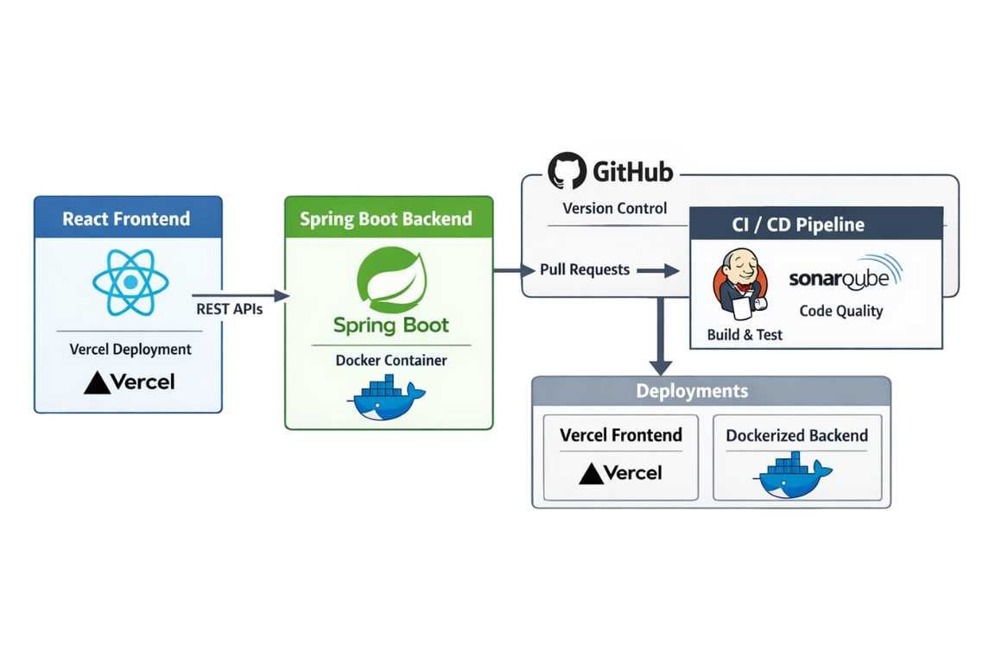
Resort CRM
Intro
Backend
Frontend
System Architecture
Architecture Flow:
  React frontend communicates with Spring Boot backend via REST APIs
  GitHub used for version control
  Pull Request–based CI pipeline
  SonarQube for code quality checks
  Backend dockerized locally
  Frontend deployed on Vercel
resort-crm-by-dk.vercel.app

Slide 4
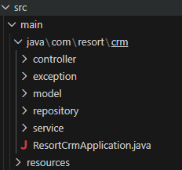
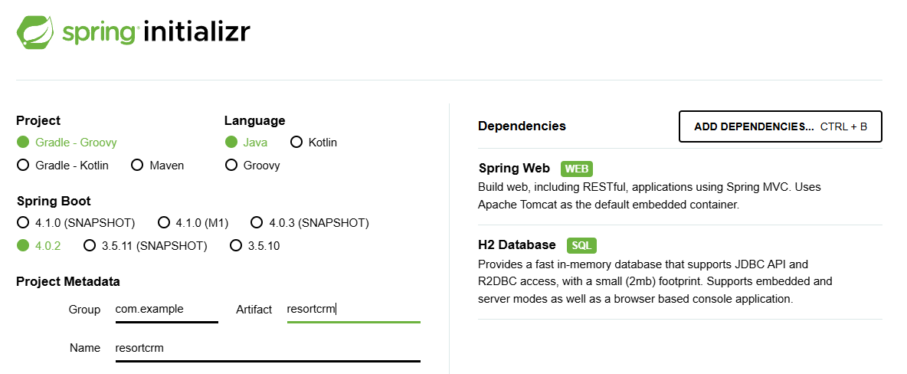
Resort CRM
Intro
Backend
Frontend
Backend Development
  Project initialized using Spring Initializr
  Maven-based Spring Boot application
  Layered architecture:
  Controller
  Service
  Repository
  Entity
  REST APIs using JSON
resort-crm-by-dk.vercel.app

Slide 5
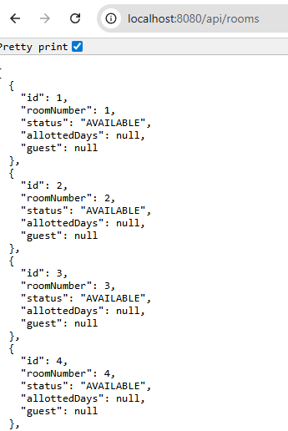
Resort CRM
Intro
Backend
Frontend
Backend Execution
  Application executed using: mvn spring-boot:run
  Backend accessible at: http://localhost:8080
  APIs tested using browser
  For Example : /api/rooms
resort-crm-by-dk.vercel.app

Slide 6
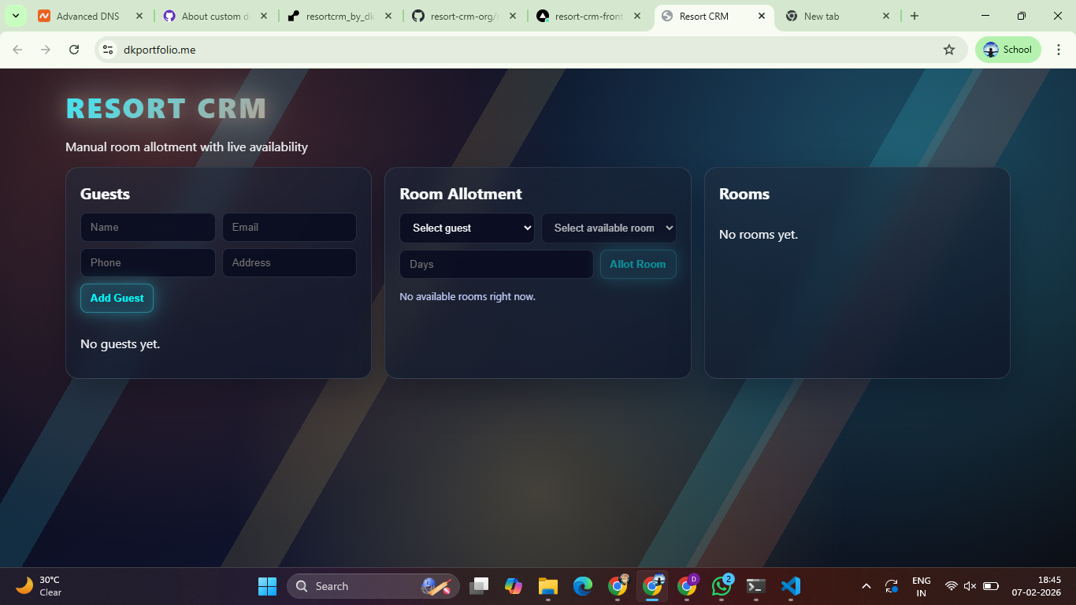
Resort CRM
Frontend
Git
CI
Frontend Development
  Frontend developed using React
  Component-based architecture
  API integration using Axios / Fetch
  Local execution: npm start
  Runs on: http://localhost:3000
resort-crm-by-dk.vercel.app

Slide 7
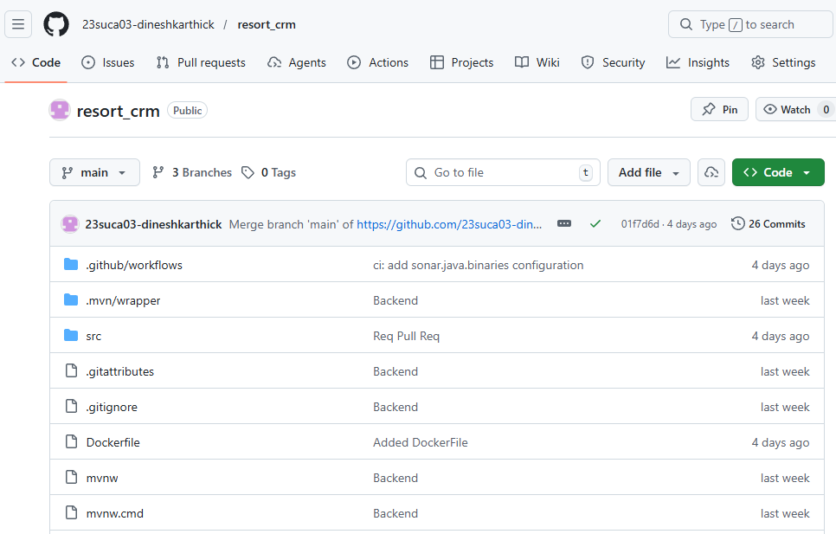
Resort CRM
Frontend
Git
CI
Version Control & CI Pipeline
  Git used for source control
  GitHub repository with branch-based workflow
  Pull Requests used for merging changes
  CI pipeline triggered automatically on PR
resort-crm-by-dk.vercel.app

Slide 8
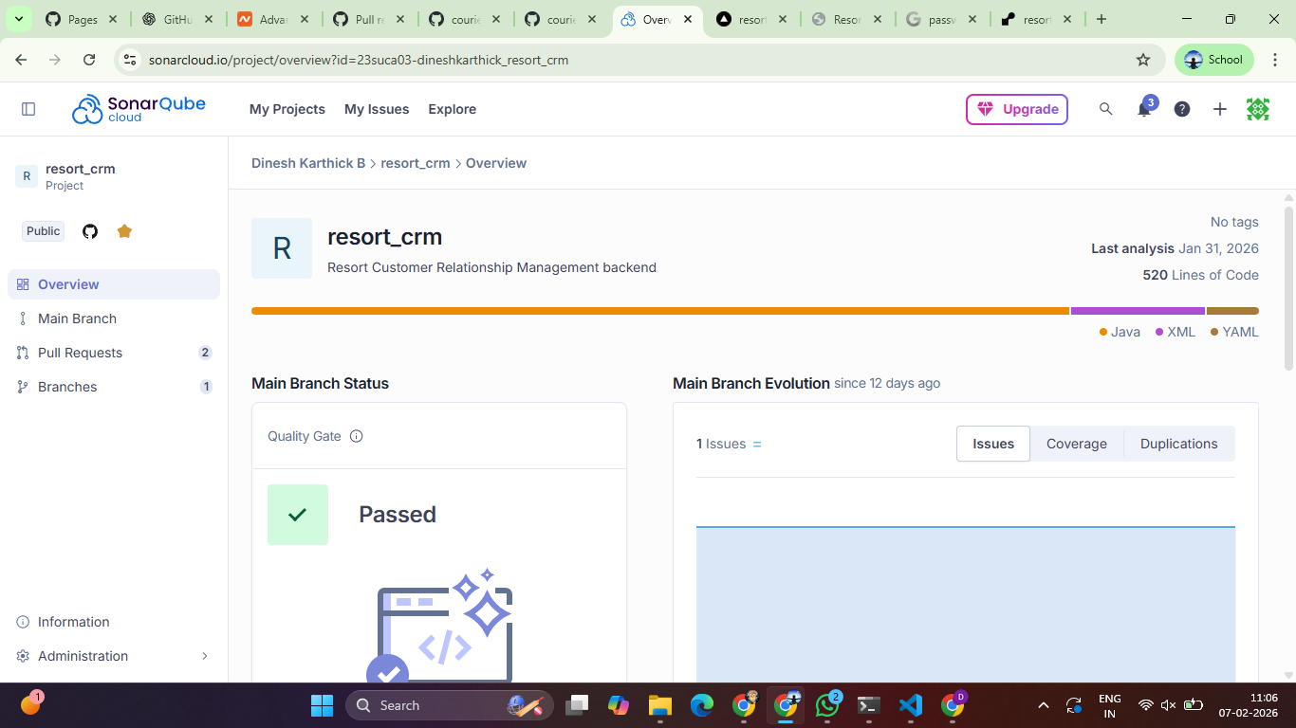
Resort CRM
CI & SonarQube
Docker
Vercel
CI & SonarQube Integration
  SonarQube integrated into CI pipeline
  Static code analysis performed during PR
  Quality Gate must pass before merge
Checks for:
  Bugs
  Code smells
  Security issues
resort-crm-by-dk.vercel.app

Slide 9
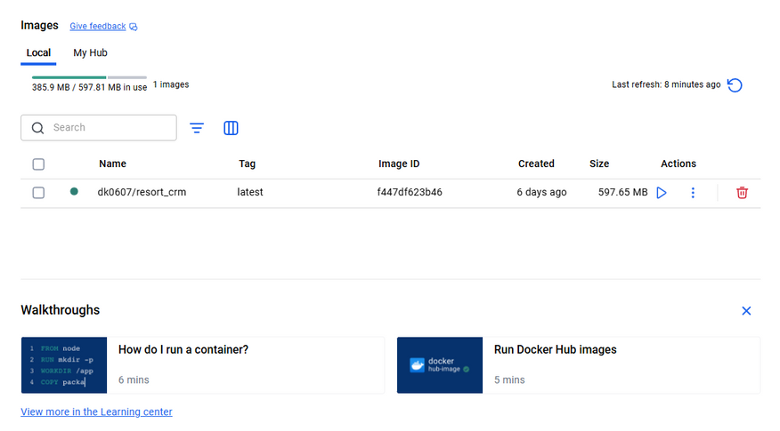
Resort CRM
CI & SonarQube
Docker
Vercel
Backend Dockerization
  Spring Boot backend dockerized for local testing
  Dockerfile created using OpenJDK base image
  Backend verified inside Docker container
Docker commands used:
  docker build -t resort_crm_backend .
  docker run -p 8080:8080 resort_crm_backend
resort-crm-by-dk.vercel.app

Slide 10
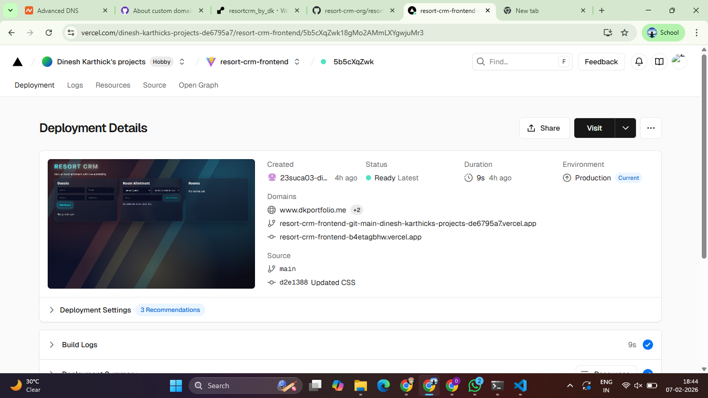
Resort CRM
CI & SonarQube
Docker
Vercel
Frontend Deployment
  Frontend deployed using Vercel
  GitHub repository connected to Vercel
  Automatic build and deployment
  Live frontend accessible via Vercel URL
resort-crm-by-dk.vercel.app

Slide 11
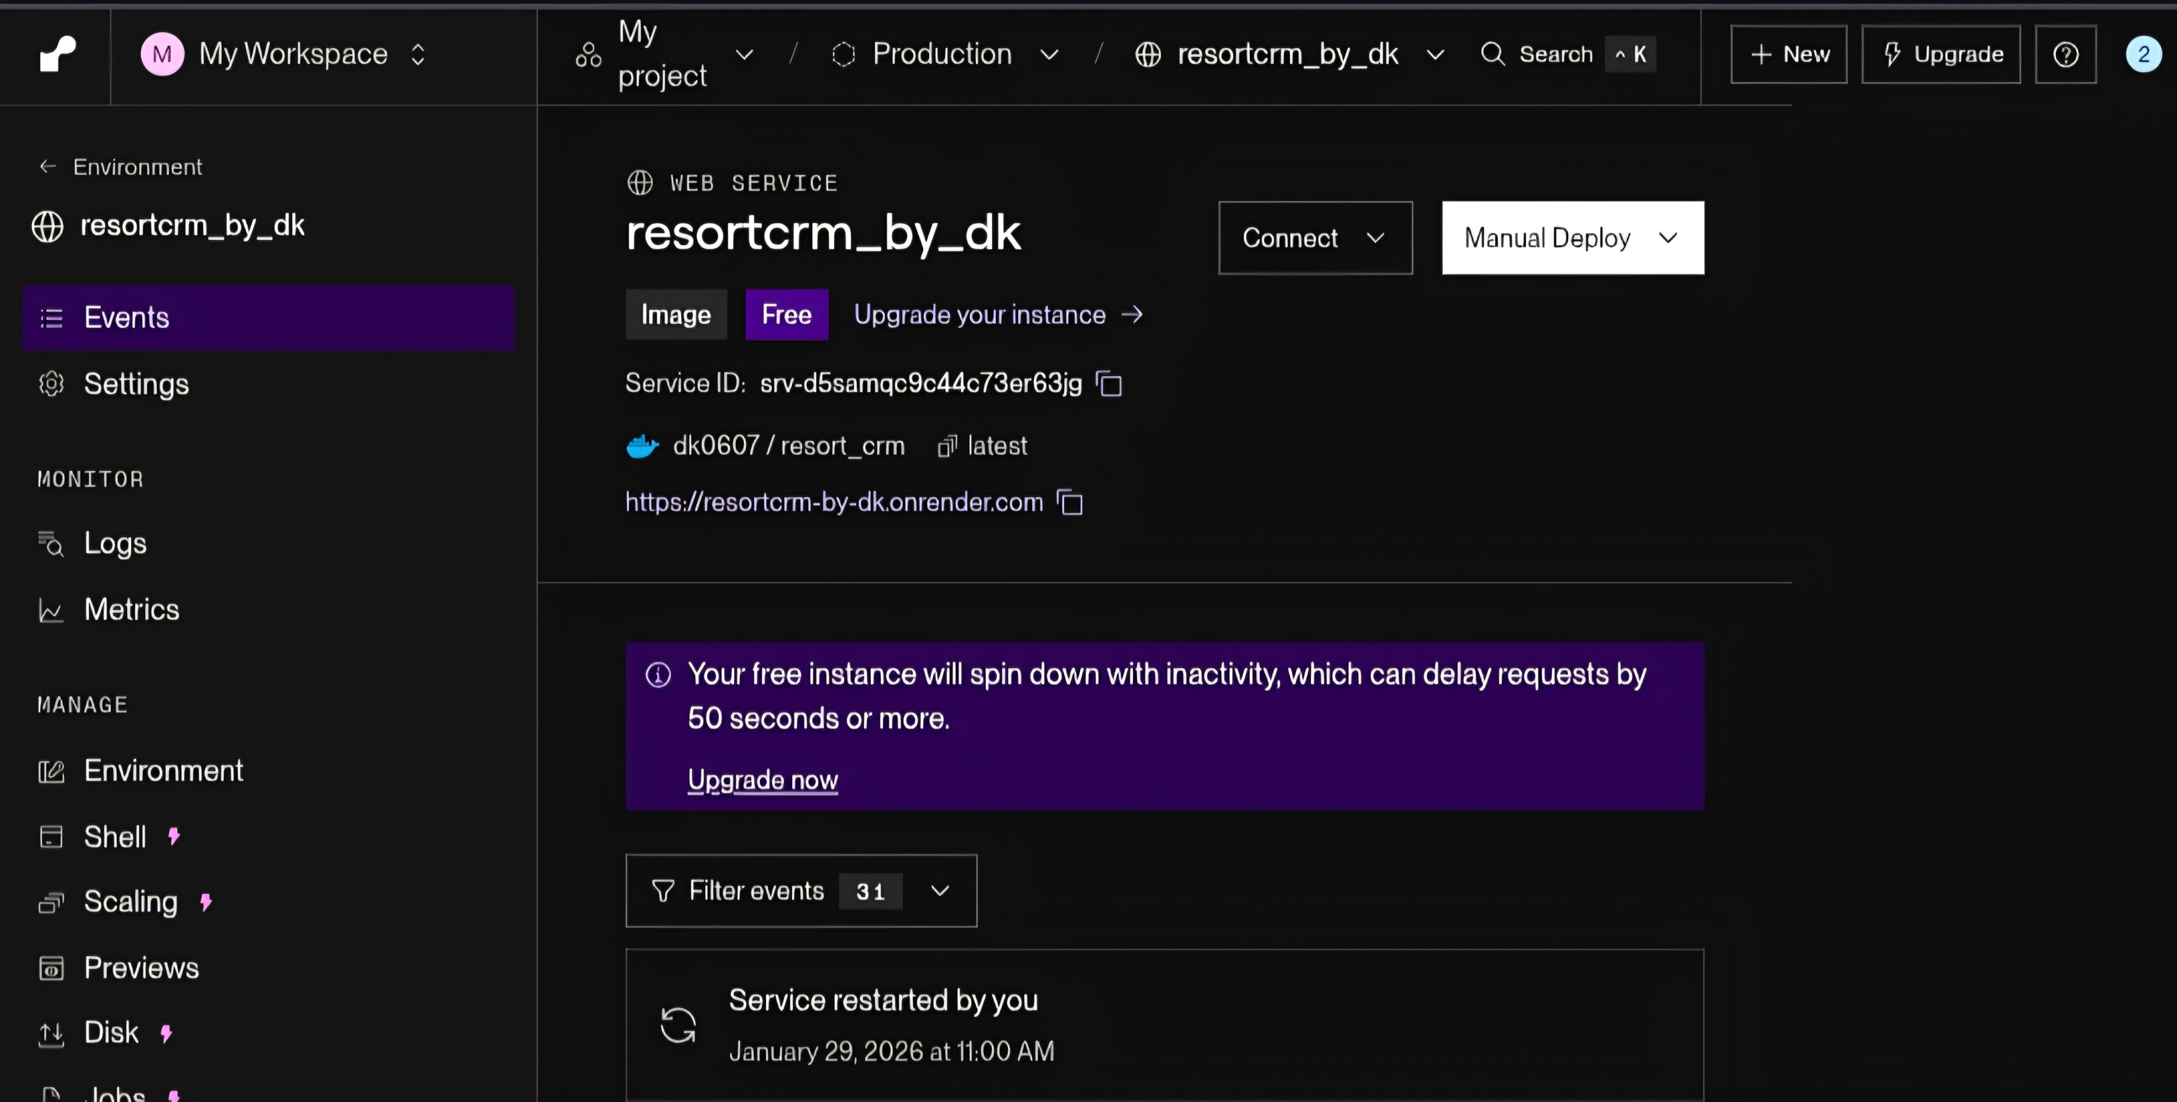
Resort CRM
Docker
Versal
Render
Backend Deployment (Optional)
  Spring Boot backend containerized using Docker
  Dockerfile created with OpenJDK base image
  Backend runs inside Docker on port 8080
  Deployed and tested in local Docker environment
resort-crm-by-dk.vercel.app

Slide 12
Resort CRM
Vercel
Render
Isses Faced
Issues Faced & Solutions
Issues Faced
Solutions Implemented
  Docker Desktop startup issues
  Port conflicts (8080 already in use)
  CORS errors between frontend & backend
  SonarQube quality gate failures
  Enabled virtualization & restarted Docker services
  Resolved port conflicts by freeing/changing ports
  Configured CORS settings in Spring Boot
  Refactored code to meet SonarQube quality standards
resort-crm-by-dk.vercel.app

Slide 13

Dinesh Karthick B
Backend
Frontend
Conclusion
Thank You
FOR YOUR ATTENTION
Dev Ops Internal Presentation
resort-crm-by-dk.vercel.app

